Slide 1

Efficient Estimation of Word Representations in Vector Space
Vignesh Mallya, 4 Nov 2024 (Student 1)
Reference: Mikolov, T., 2013. Efficient estimation of word representations in vector space. arXiv preprint arXiv:1301.3781, 3781.

Slide 2
Word2Vec? and Why?
Example:
The kid said he would grow up to be superman
The child said he would grow up to be superman

Slide 3
Word Embedding Intuition
Attribute | Battle | Horse | King | Man | Queen | Woman
Authority | 0.8 | 0.2 | 1 | 0.6 | 1 | 0.5
Event | 1 | 0 | 0 | 0 | 0 | 0
Has Tail? | 0 | 1 | 0 | 0 | 0 | 0
Rich | 0.1 | 0.5 | 1 | 0.4 | 1 | 0.3
Gender | 0 | 1 | -1 | -1 | 1 | 1
King
1
0
0
1
-1
Man
0.6
0
0
0.4
-1
Woman
0.5
0
0
0.3
1
0.9
0
0
0.9
1
Queen
1
0
0
1
1
-
+
=
≈

Slide 4
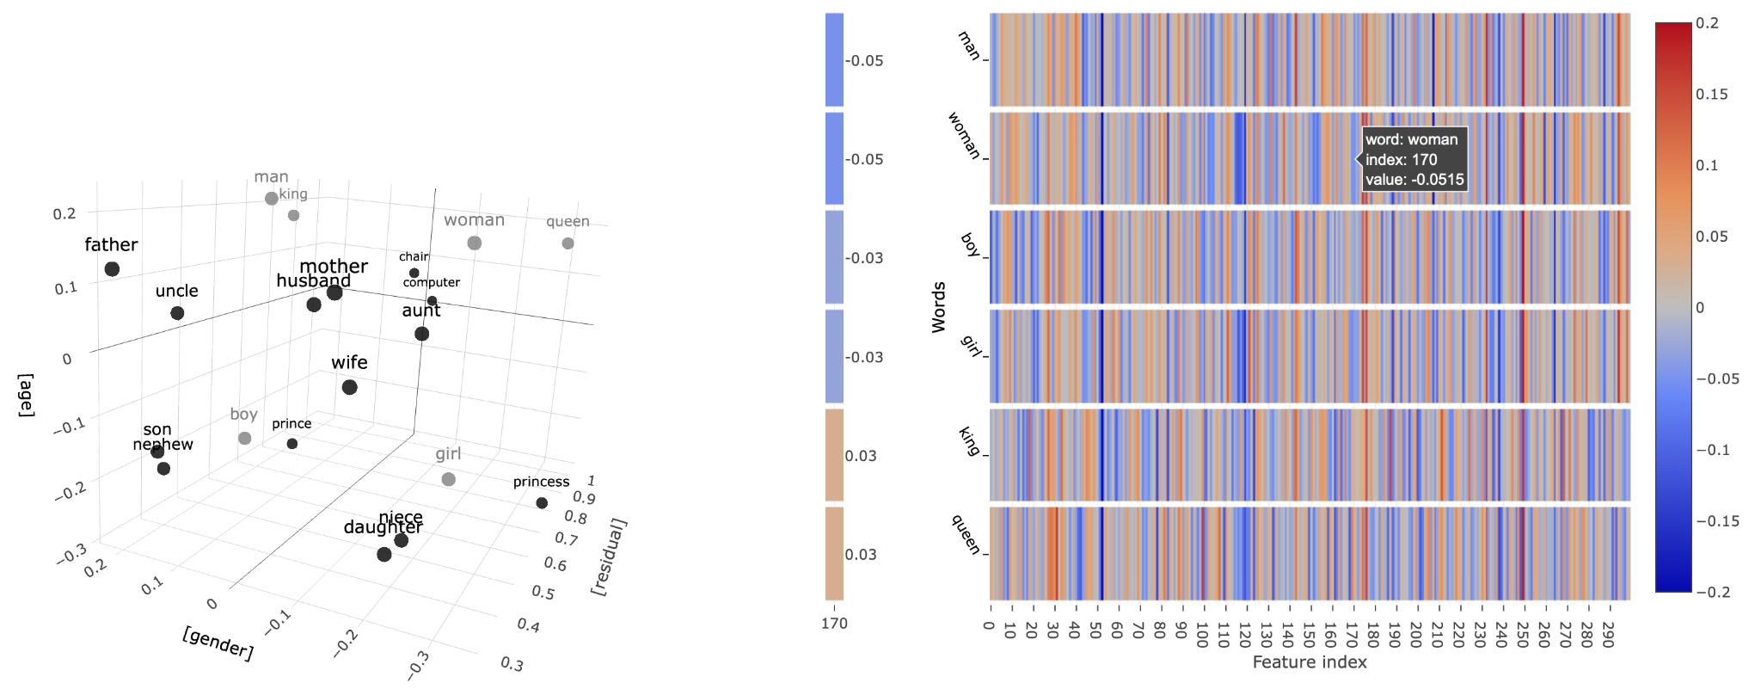
Word Embedding Intuition
Word Vector Projection
Vector Visualization
Reference: https://www.cs.cmu.edu/~dst/WordEmbeddingDemo/

Slide 5
Word2Vec
Model Architectures
CBOW: Continuous Bag Of Words
2) Skip Gram
Given context words predict target word
Given the target predict context words
Sentence: "Quick brown fox jump over"
Quick | brown | fox | jump | over
Quick | brown | fox | jump | over
Context
Target
Context
Target
Context
Target

Slide 6
Model Architecture
CBOW: Continuous Bag of Words
Input Layer 1*V
10000
Forward Propagation
Sentence: "Quick brown fox jump over"
W_{V*N}
01000
Output Layer
Minimum Loss
Hidden Layer
ŷ
≈
y
W_{V*N}
00100
W_{N*V}
00010
W_{V*N}
N-dimensional Vector
Softmax
Actual target word
W_{V*N}
V-dim
00001
Back Propagation
Word Embedding
One Hot Encoded Vector

Slide 7
Model Architecture
CBOW: Continuous Bag of Words
Input Layer 1*V
10000
Forward Propagation
Sentence: "Quick brown fox jump over"
W_{V*N}
01000
Output Layer
Hidden Layer
ŷ
≈
y
W_{V*N}
00100
00010
W_{V*N}
N-dimensional Vector
Softmax
Actual target word
W_{V*N}
V-dim
00001
Back Propagation
Word Embedding
One Hot Encoded Vector

Slide 8
Model Architecture
CBOW: Continuous Bag of Words
Input Layer 1*5
10000
Quick
Brown
fox
jump
over
Sentence: "Quick brown fox jump over"
W_{5*3}
Quick
Brown
fox
jump
over
01000
Output Layer
Hidden Layer
ŷ
≈
y
W_{5*3}
00100
Quick
Brown
fox
jump
over
W_{3*5}
Quick
Brown
fox
jump
over
00010
W_{5*3}
3-dimensional Vector
Softmax
Actual target word
W_{5*3}
5-dim
Quick
Brown
fox
jump
over
00001
Word fox = [0.5, 0.3, 0.01]
One Hot Encoded Vector

Slide 9
Model Architecture
Skip Gram
Actual context word
≈
Output Layer 1*V
10000
Forward Propagation
W_{N*V}
01000
Input Layer
Hidden Layer
00100
W_{N*V}
W_{V*N}
00010
W_{N*V}
N-dimensional Vector
One hot encoded vector
W_{N*V}
00001
Word Embedding
Back Propagation
Softmax

Slide 10
Model Architecture
Skip Gram
Output Layer 1*V
Actual context word
10000
Quick
Brown
fox
jump
over
W_{5*3}
01000
Quick
Brown
fox
jump
over
Input Layer
Hidden Layer
Quick
Brown
fox
jump
over
00100
W_{5*3}
W_{3*5}
00010
Quick
Brown
fox
jump
over
W_{5*3}
N-dimensional Vector
One hot encoded vector
W_{5*3}
00001
Quick
Brown
fox
jump
over
Softmax

Slide 11
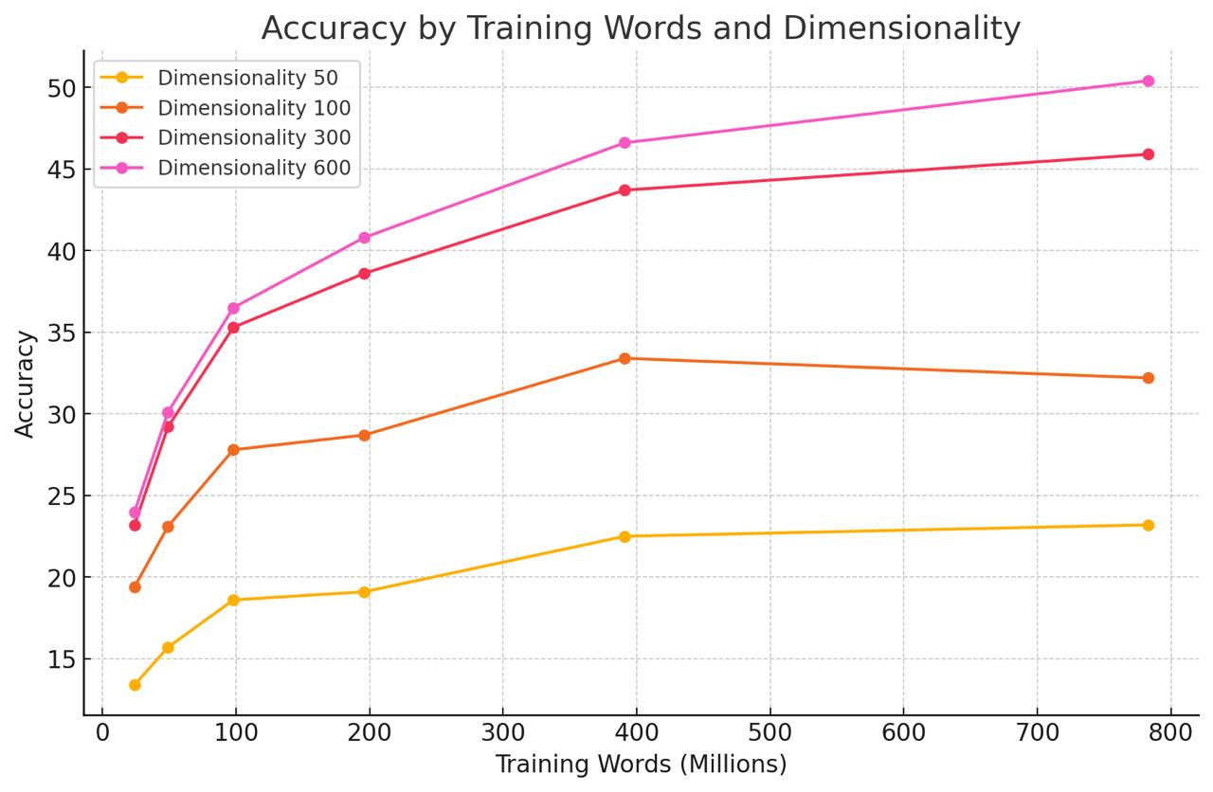
Word2Vec
Results for CBOW Architecture
Word2Vec: Google news corpus data was used to train word vectors 6 Billion tokens (restricted to 1B most frequent words)
Fig1: Subset of training data with vocabulary restricted to 30k most frequent words

Slide 12
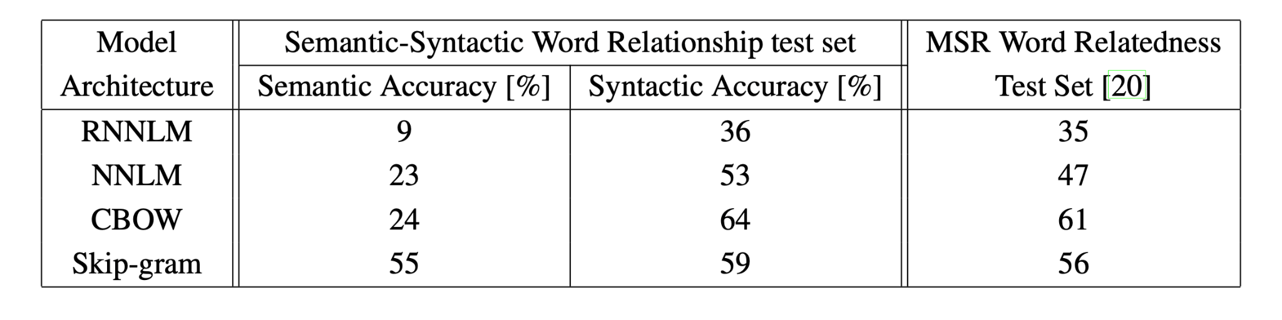
Word2Vec
Comparison of Architectures
Reference: Efficient Estimation of Word Representation in Vector Space
Fig2: Comparison of architectures using models trained on the same data, with 640-dimensional word vectors

Slide 13
Word2Vec
Conclusion
High quality representation of words into vectors
Simple architecture and scalable
Lower computational complexity
Captures syntactic and semantic meanings

Slide 14
THANK YOU

Slide 15
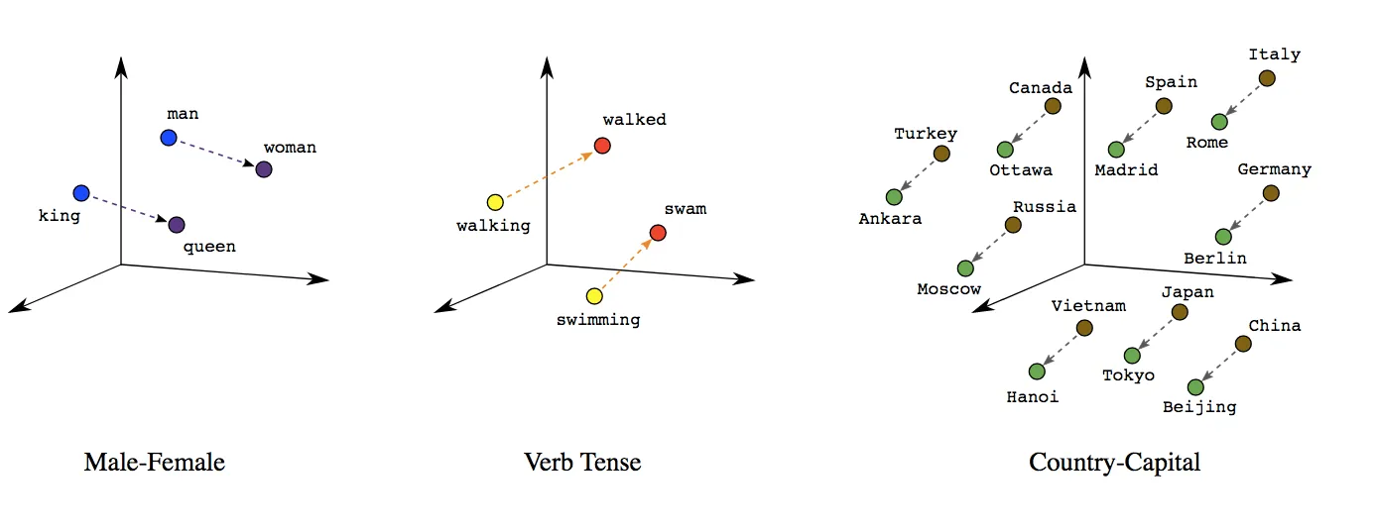
Reference:https://towardsdatascience.com/a-guide-to-word-embeddings-8a23817ab60f

